Slide 1


“Ente Varthakal ”

Slide 2
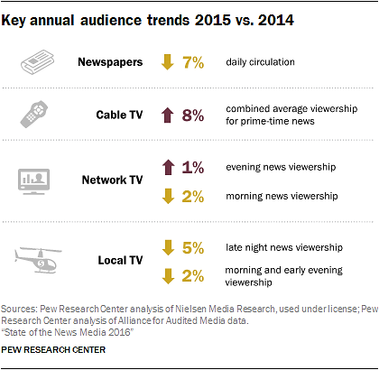

CURRENT SCENARIO
Limited personalization
Manual news selection
WHO DOES IT NOW?
www.experionglobal.com

Slide 3
“Facebook & Twitter do personalization best”
41%
People accessing news via Facebook
Marketers see an average increase of 20% in sales when using personalized web experiences
www.experionglobal.com

Slide 4

WHAT CAN BE DONE?
Provide PERSONALIZED content
AUTOMATE news suggestions
www.experionglobal.com

Slide 5

REVENUE DRIVERS
Hike in Readership
Hike in Subscriptions (Hybrid)
Focused Advertisements
www.experionglobal.com

Slide 6
ACHIEVING PERSONALIZATION
User Preference
Semantic Results
Collaborative Filtering : User/Item-based recommendations
Personalized Semantic Search
Contextual Focused Advertisements
www.experionglobal.com

Slide 7







Powered By :
www.experionglobal.com

